Slide 1
KESHAV MEMORIAL INSTITUTE OF TECHNOLOGY
Accredited by NBA & NAAC, Approved by AICTE,
Affiliated to JNTUH, Hyderabad
A Major Project Presentation on
A PRACTICAL DEEP LEARNING-BASED INVENTORY MANAGEMENT SYSTEM
FOR OBJECT-DETECTION OF INVENTORY ITEMS AND STOCK COUNT
Guide: Mr. Y Singaraiah
Submitted By:
M Dharani | 20BD1A6686
B Pranitha | 20BD1A6665
K Sainidhi | 20BD1A66A7
Y Shriya Sravani | 20BD1A66C0

Slide 2
Index
Abstract
Objectives
Literature Survey
Drawbacks to existing system
About Dataset
System Design
Methodology
Implementation
Output
Performance Metrics
Conclusion

Slide 3
Abstract
In the fast-paced business world of today, efficient inventory management is a critical factor in ensuring the smooth operation of supply chains and, ultimately, in enhancing customer satisfaction. The interface allows inventory managers to easily access detailed item information and monitor inventory status. Simultaneously, a deep learning model is deployed to identify items within live video streams captured by devices, reducing the potential for errors and eliminating the need for manual intervention. A standout advantage of this system is its real-time inventory updating capability. When the deep learning model identifies items, it communicates directly with the central inventory database, ensuring swift updates to inventory quantities. The constantly updated inventory list is readily accessible on the website's frontend, empowering users to make informed decisions regarding inventory management.

Slide 4
Objectives
• This project aims to reduce human intervention and increase efficiency in managing large amount of inventory items.
• An exploratory data analysis is done on a dataset of different inventory items by annotating and expanding the dataset using augmentation.
• A deep learning model is employed to scan images and capture real-time video feeds from cameras placed in the inventory storage areas. By analyzing the visual data, the system can pinpoint the items' exact positions in real-time, eliminating the need for manual counting and tracking.
• The inventory management system, keeps a continuous and up-to-date count of the available stock for each inventory item and the count is displayed through a dashboard.

Slide 5
Literature Survey
1) Real Time Object Detection using YOLO Algorithm
This research work aims to perform object detection by using the You Look Only Once (YOLO) method. This method is much efficient to the existing models in terms of speed and performance. Some of the algorithms do not scan all the regions in single forward propagation but in YOLO, the algorithm analyzes the entire image by predicting binding boxes using convolutional neural network and class opportunities. YOLO performs faster when compared to other algorithms.

Slide 6
2) Object Detection for Inventory Stock Counting Using YOLOv5
The study developed a program using the YOLOv5 algorithm to detect specific cellphone models, Cherry Aqua S9 and Cherry Flare S8, regardless of their orientation. They collected 1,623 images of these phones in various scenarios and lighting conditions. Using 9W lighting, both phones achieved high accuracy, with S8 at 0.96 and S9 at 0.95 average accuracy. Lower lighting impacted S9's detection of a specific orientation. At 7W, S9 had issues with side view detection, while at 5W, there were more misdetections for both models. YOLOv5 proved effective in accurately identifying these phones but struggled to differentiate between similar-sized objects. Increasing the dataset improved accuracy, showing high precision and recall with minimal losses.

Slide 7
3) Object Detection on Bottles Using the YOLO Algorithm
Object recognition is a tool that is often used in today's digital era. Object recognition can identify an object. However, we cannot identify every single object unless the object has been tagged and studied by the machine. Our goal in this research is to create a program that can detect bottles with the YOLOv3 and COCO datasets and a simple architectural model that can be easily practiced. In this research, we will use YOLO, and the dataset is taken, or the objects that can be identified are only objects in the COCO dataset. Then we do object recognition of the bottles that we collect ourselves as a real case data test. We found that YOLOv3 is better at detecting objects than YOLOv2 with the same dataset.

Slide 8
Drawbacks Of Existing Systems
Traditional systems often rely on manual data entry, which is time-consuming and prone to errors. This can lead to inaccuracies in inventory records and mismanagement of stock levels.
As businesses grow, the limitations of scalability in traditional systems become apparent. The previous systems have not been able to implement multi-class object tracking and detection. Existing systems struggle to adapt to a larger inventory.
Yolov5 model used in cellphone inventory detection was unable to the detect similar items and items of smaller size. The Yolov7 and Yolov8 models are better at detecting the objects and make precise bounding boxes. This improves the precision and accuracy of the model being trained.
Existing systems for inventory item count implement only Yolov5 model which gives less accurate results as compared to its successive models.
Existing systems have used public datasets which consist of only images that have to be preprocessed and require the outliers to be removed.

Slide 9
About Dataset:
Raw Dataset Collection: Gathered a diverse dataset of inventory items with images taken from Google in different angles, lighting conditions, and backgrounds. The data collected can be divided into 5 categories:
1. Noodles 3. Lays 5. Biscuits 1:Maggie 1:Blue Lays 1:Goodday blue 2:Yippee 2:Red Lays 2:Goodday green
3:TopRamen 3:Yellow Lays 3:Goodday orange
2. Shampoo 4. Cool Drinks
1:Head&Shoulders 1:Coco Cola 2:Meera 2:Fanta 3:Tresemme 3:Pepsi

Slide 10
Dataset Annotation-Annotate the dataset with bounding boxes around each inventory item to indicate their positions within the images using Roboflow.
Resize-Adjust image dimensions to a desired size, such as resizing all images to 640x640 pixels.
Auto-Orient-Automatically adjust image orientation to a standard orientation, ensuring consistency across the dataset.
Data Augmentation-Expand the dataset using data augmentation techniques such as rotation, scaling, flipping, cropping, and adding noise. Augmenting the dataset increases its diversity and robustness, improving the model's ability to generalize to unseen data.

Slide 11
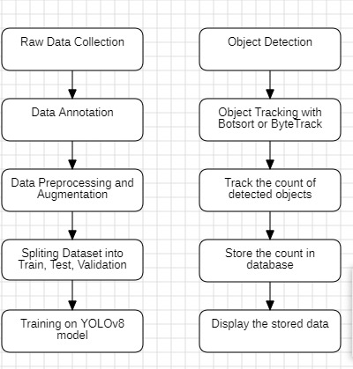
System Design
Workflow Diagram

Slide 12

NOODLES
SELECT DATE
SHAMPOO
Use Case Diagram
LAYS
DRINKS
USER
SELECT CATEGORY
BISCUIT
DISPLAY DATA
DATA
DETECT OBJECTS IN IMAGE
IMAGE
SELECT SOURCE
VIDEO
DETECT OBJECTS IN VIDEO
DISPLAY AND STORE COUNT IN DATABASE
WEBCAM
RTSP
YOUTUBE
TRACK OBJECTS IN VIDEO
DATABASE

Slide 13
Methodology:
1. Dataset Preparation:
Collected and Annotated images using Roboflow of various items including Packaged Noodles, Shampoo Bottles, Lays, Goodday Biscuits, and Soft Drinks for training the YOLO models.
2. Model Training:
Trained the model on the annotated dataset to recognize the specified items. Utilized various YOLO model architectures for object detection. Exported the trained weights of the YOLOv8 model.
3. Interface Development with Streamlit:
Implemented functionalities to allow users to upload images, upload videos, webcam feeds, RTSP streams, and YouTube videos.

Slide 14
4. Object Detection and Tracking:
Only detecting objects within individual frames is insufficient for comprehensive inventory management. Hence object tracking algorithms have been implemented, namely BotSort and ByteTrack.These algorithms facilitated the continuous tracking of detected objects across consecutive frames in videos, enabling the system to monitor the movement and location of items over real time.
5. Object Counting:
Utilized the object tracking data to accurately count the number of instances of each item.Detected objects within images and videos are stored and updated accordingly in the database.
6. Display Results on Streamlit Interface:
Streamlit interface displays the results of object detection, tracking, and counting to the user by showing bounding boxes and ids of each object along with label and count.

Slide 15
7. User Interaction:
Provided interactive features for users to visualize the detected objects and their counts in real-time.
Enabled users to choose different input sources (images, videos, webcam feeds, etc.) and observe the system's detection and counting capabilities.
8. Performance Optimization:
Implemented optimizations to ensure real-time processing of uploaded content.
Fine-tuned the model and tracking algorithms for efficient and accurate object detection and counting.
9. Testing and Validation:
Conducted thorough testing to ensure the robustness and accuracy of the system.
Validated the object detection and counting results against ground truth data to assess the system's performance.

Slide 16
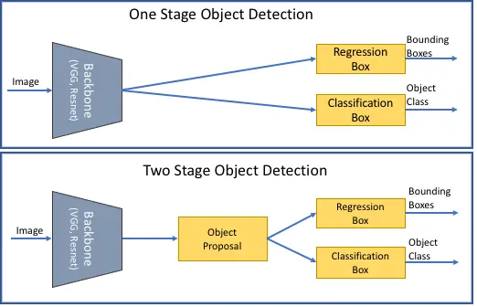
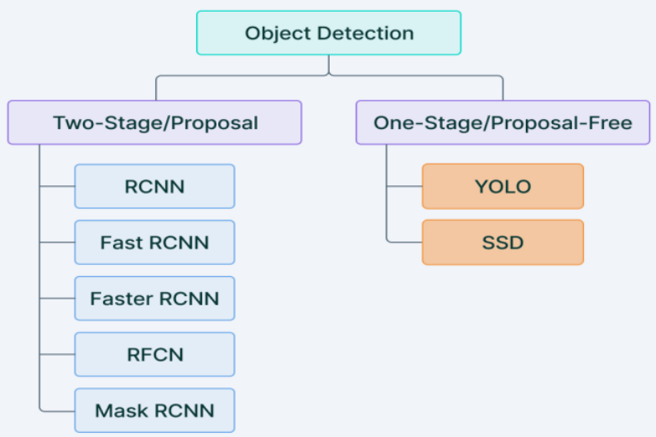
Implementation:
Object Detection

Slide 17
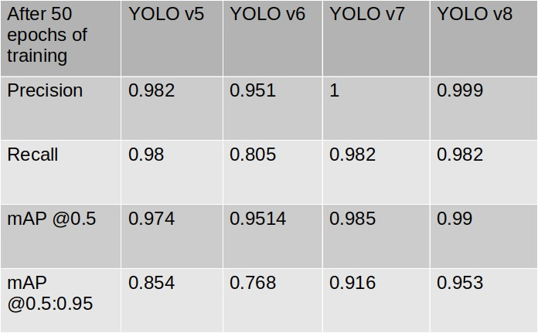
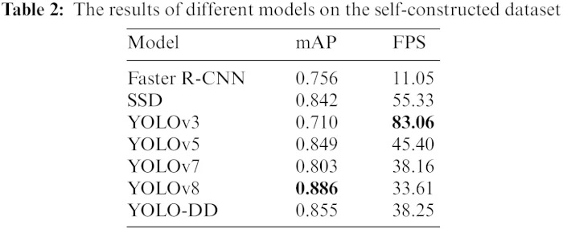
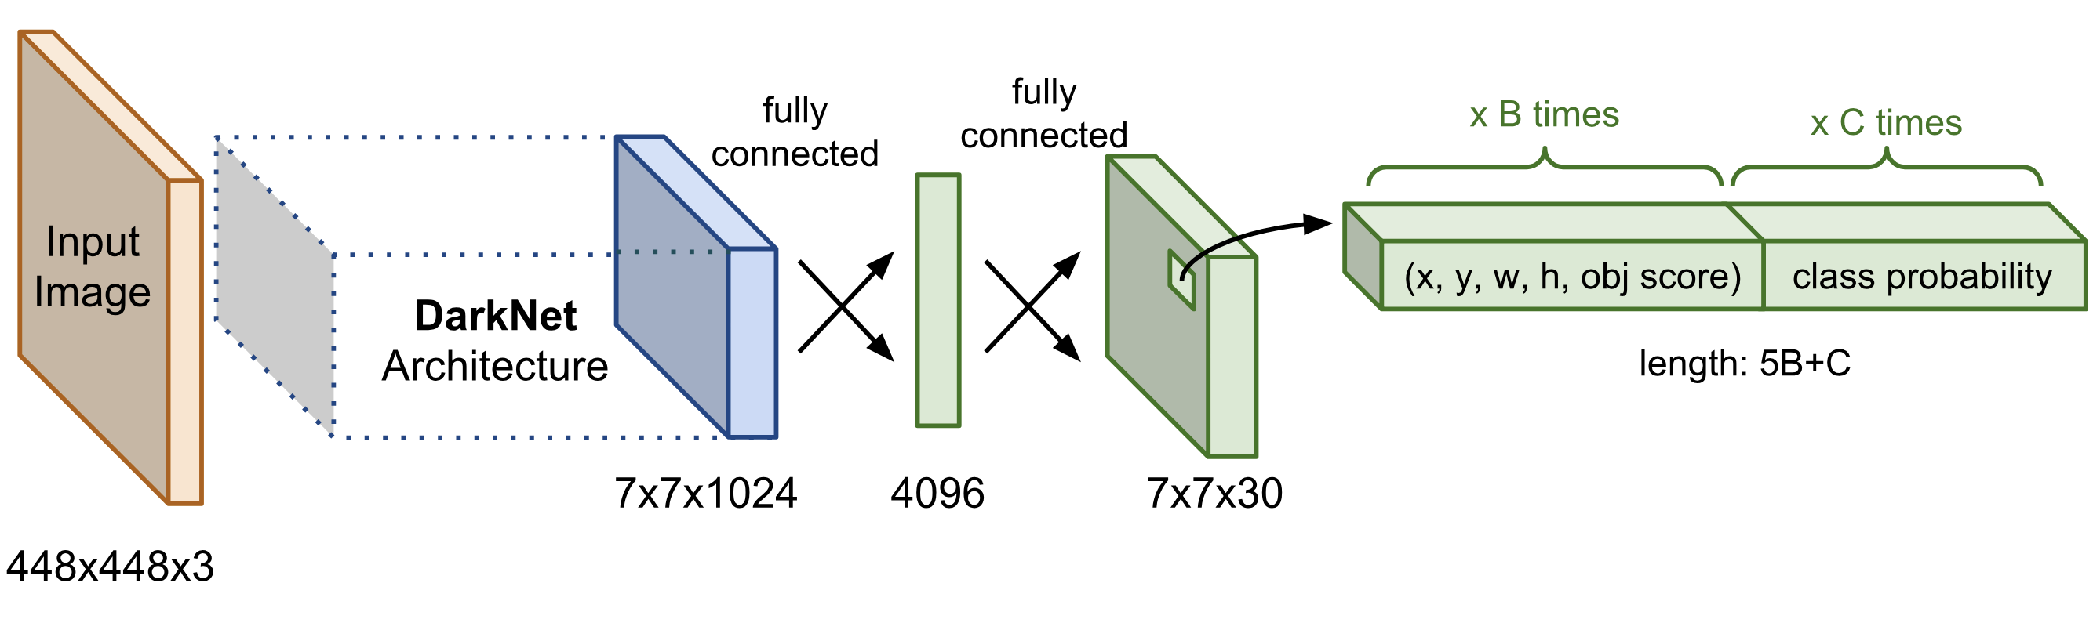
YOLO Models Comparison and Architecture

Slide 18
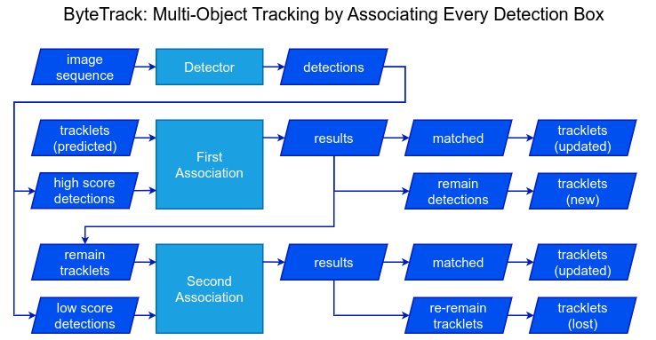
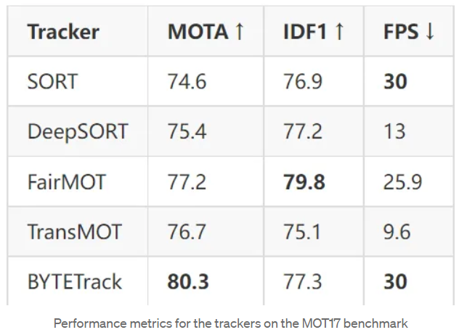
Object Tracking Algorithms

Slide 19
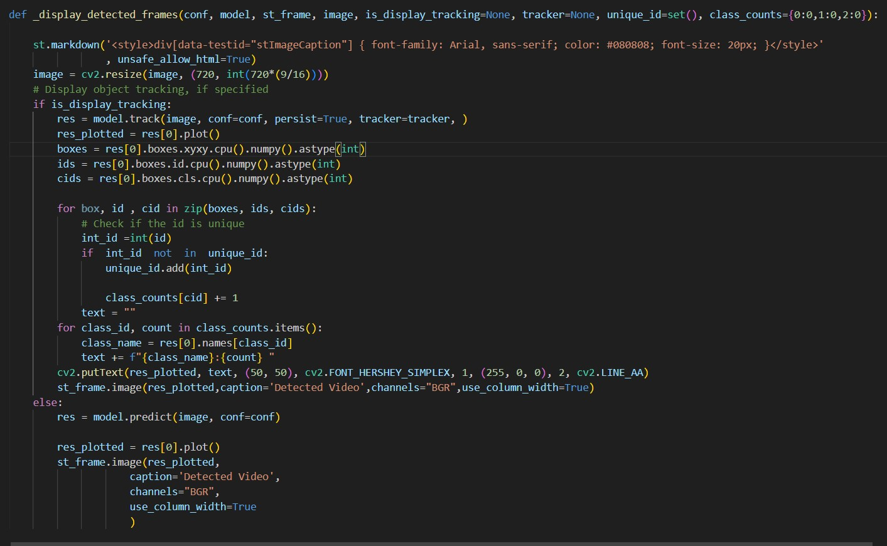
DISPLAY DETECTED FRAMES

Slide 20
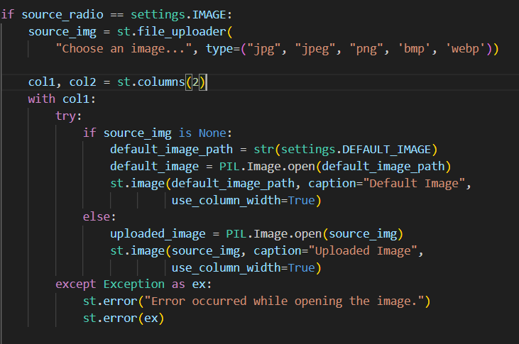
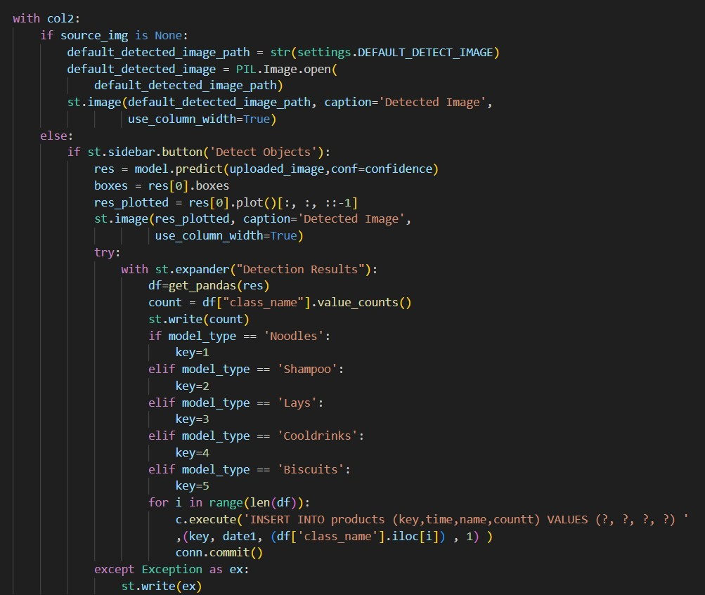
IMAGE

Slide 21
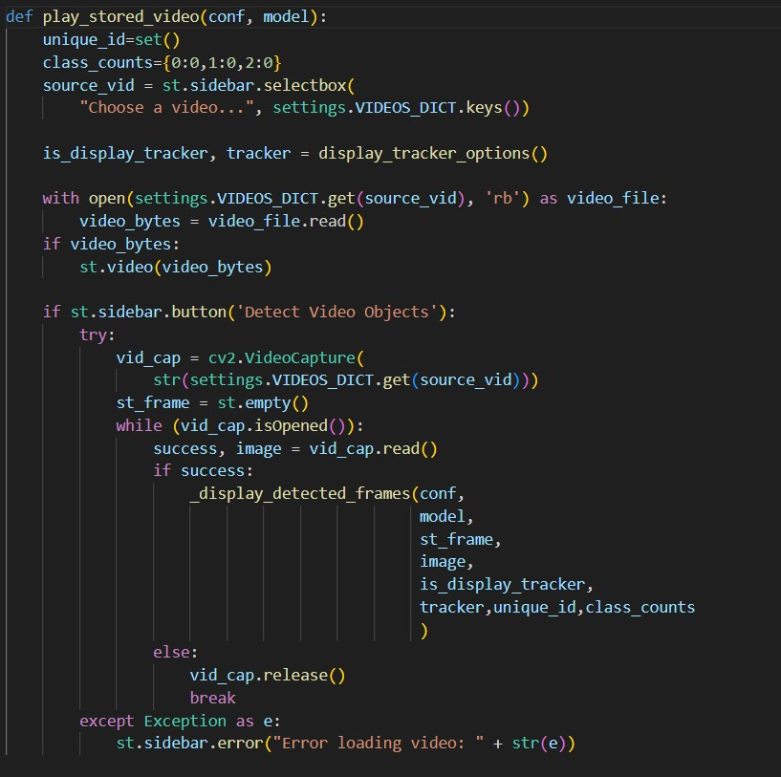
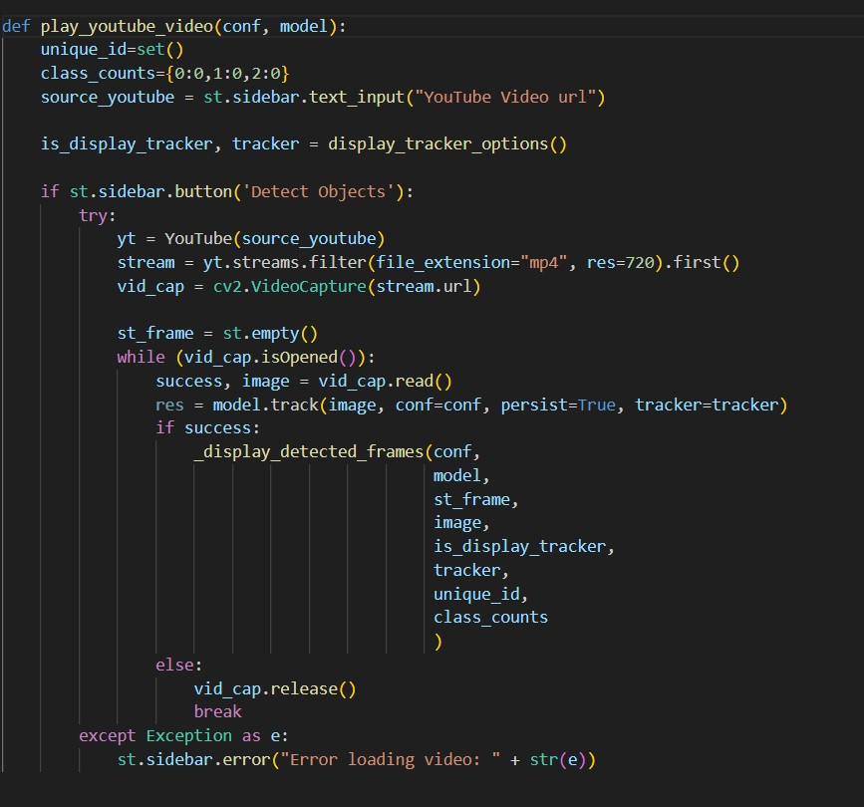
VIDEO
YOUTUBE

Slide 22
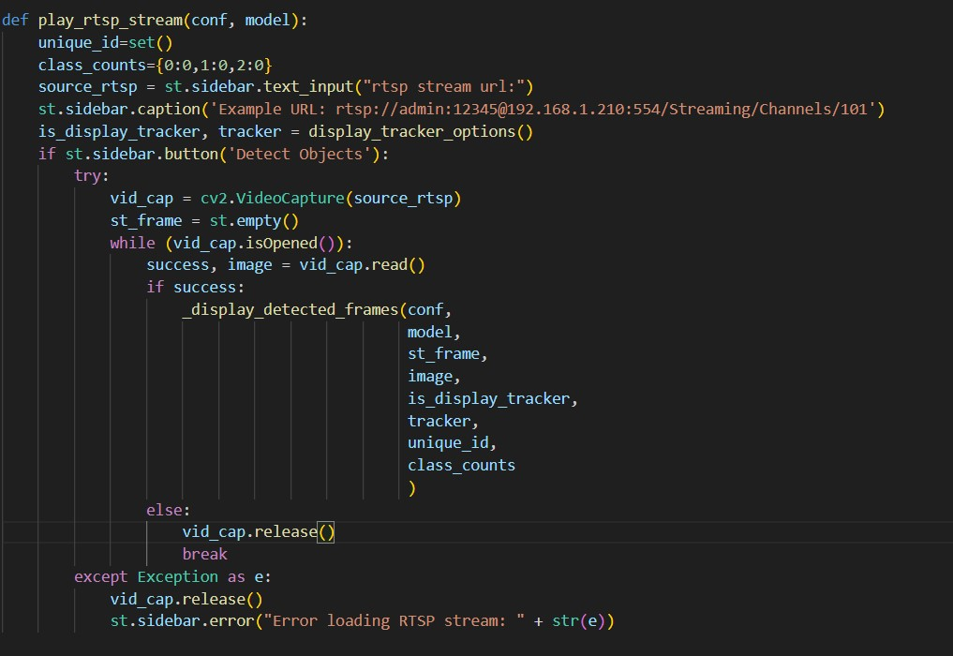
RTSP

Slide 23
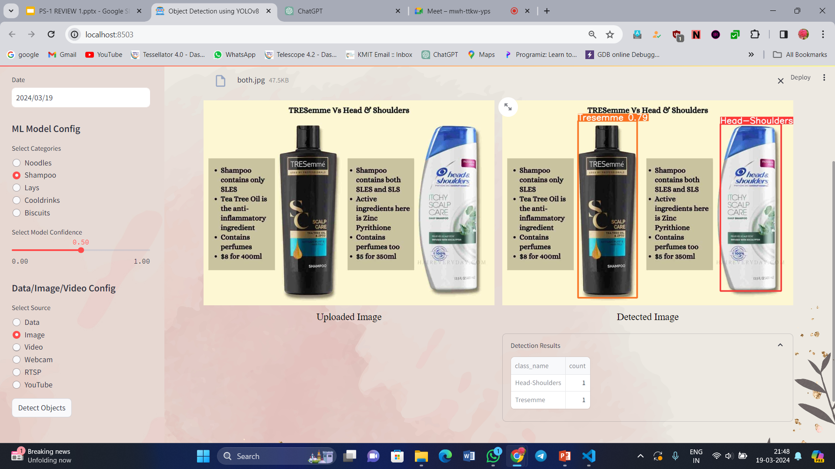
Output

Slide 24
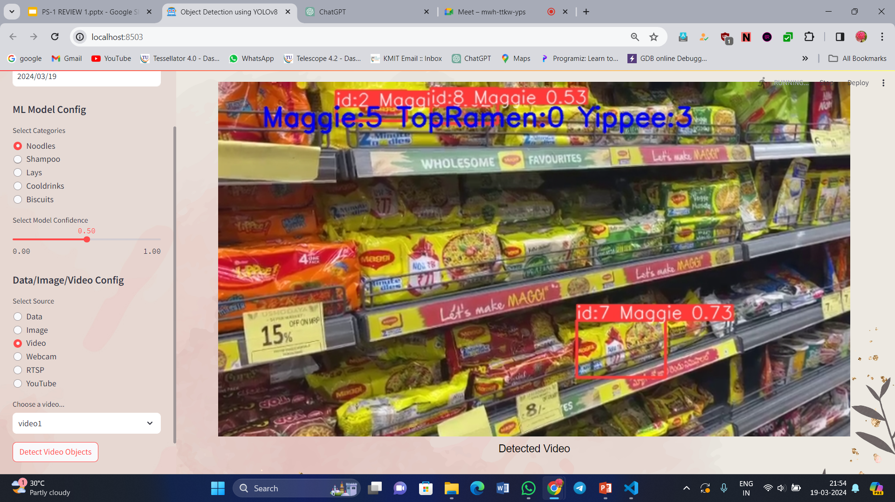

Slide 25
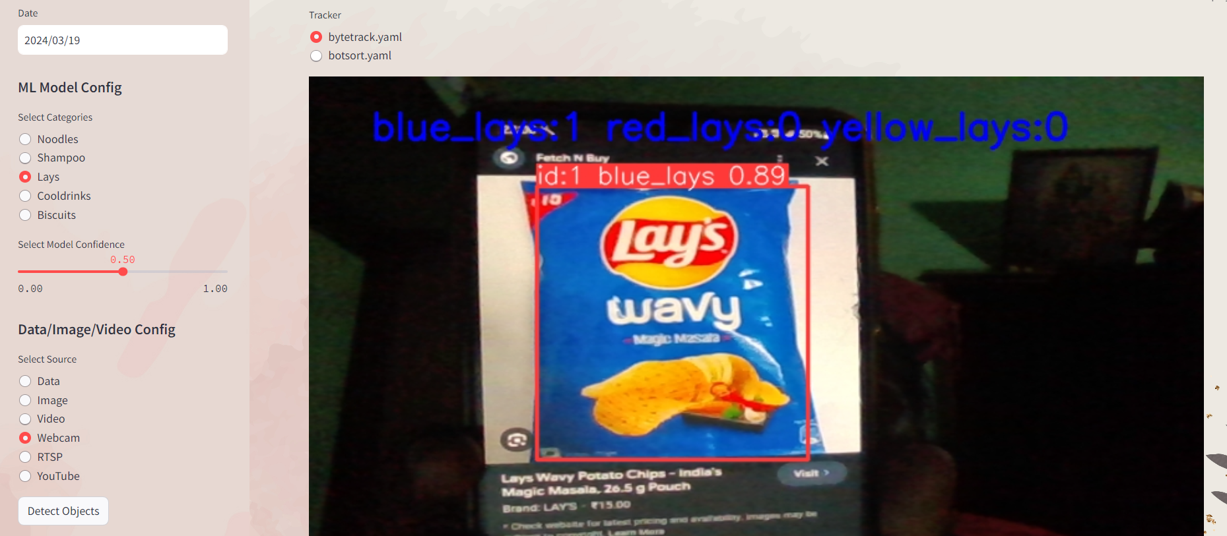

Slide 26
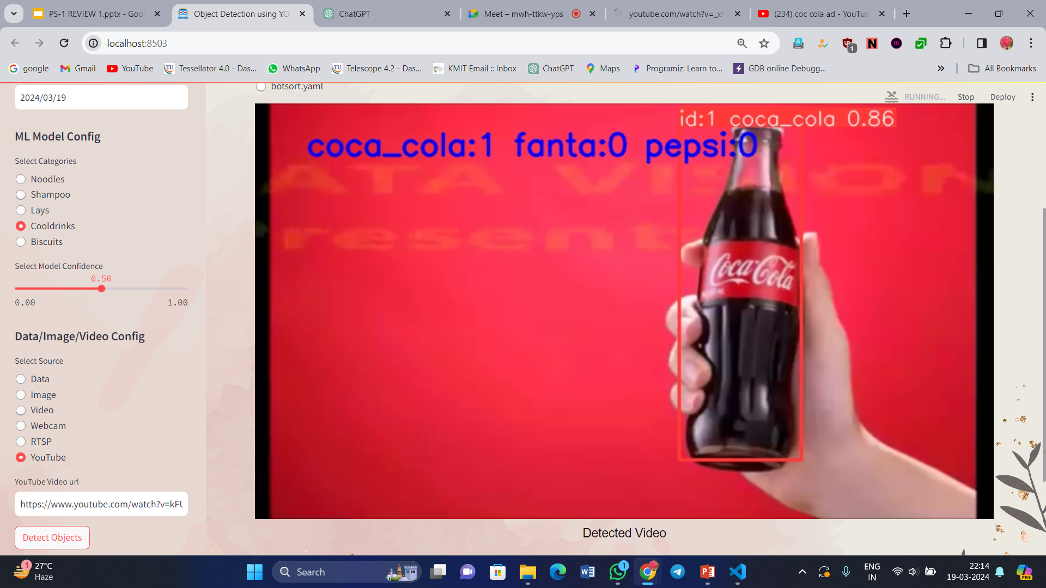

Slide 27
Performance Metrics
Class | Images | Precision (P) | Recall (R) | mAP50
Noodles | 412 | 0.863 | 0.962 | 0.953
Shampoos | 332 | 0.859 | 0.959 | 0.963
Lays | 344 | 0.868 | 0.897 | 0.898
Cool Drinks | 298 | 0.948 | 0.848 | 0.944
Biscuits | 268 | 0.915 | 0.952 | 0.969

Slide 28
Conclusion
This project harnesses YOLOv8 for real-time object detection, utilizing meticulously prepared datasets for categories like Noodles, Cool Drinks, and more. YOLOv8's single-pass neural network enables efficient detection across diverse domains, minimizing background noise for precise results. Its simplicity and effectiveness streamline model development, yielding promising outcomes. Overall, this system presents a robust and efficient object detection solution, showcasing superior accuracy, efficiency, and real-time performance, with potential applications spanning various domains.

Slide 29


